Slide 1





INVOICE DATASET

Slide 2

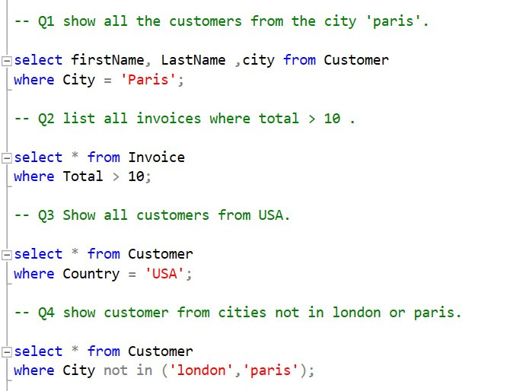
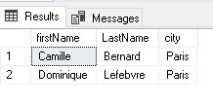
CUSTOMERS FROM PARIS

Slide 3


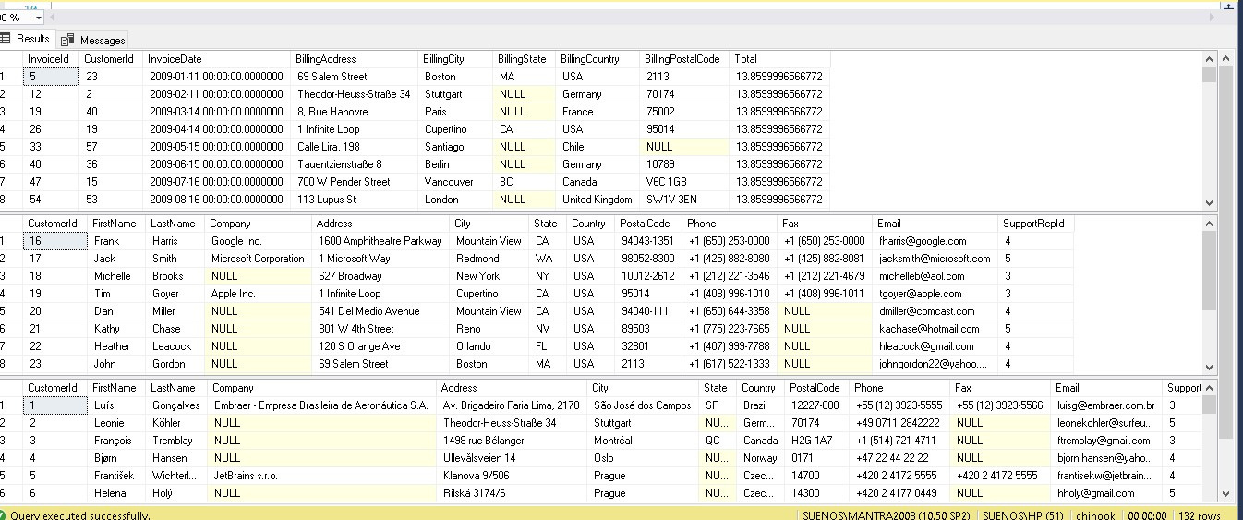
INVOICE ABOVE
. 10

Slide 4
CUSTOMER FROM USA

Slide 5
CUSTOMERS FROM CITY OTHER THAN LONDON OR PARIS

Slide 6
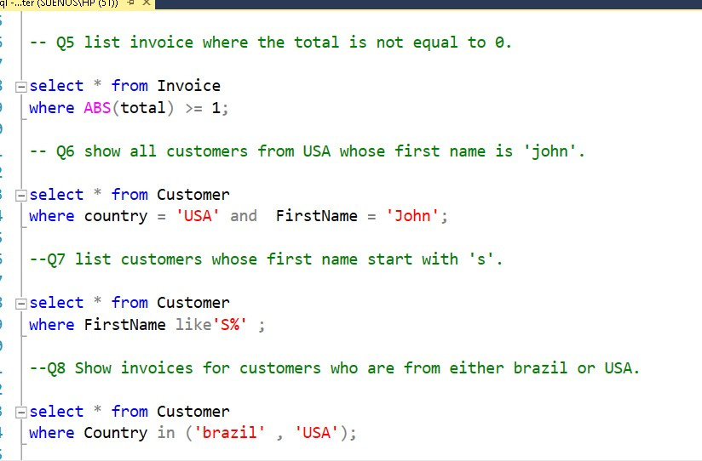
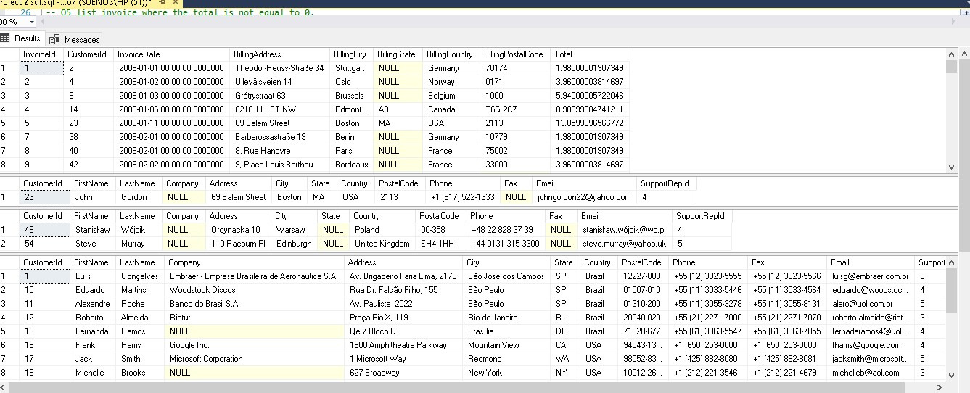
INVOICE WHERE TOTAL IS NOT 0

Slide 7
CUSTOMER WITH FIRST NAME JOHN

Slide 8
CUSTOMER WITH NAME STARTING WITH S

Slide 9
CUSTOMER FROM BRAZIL OR USA

Slide 10
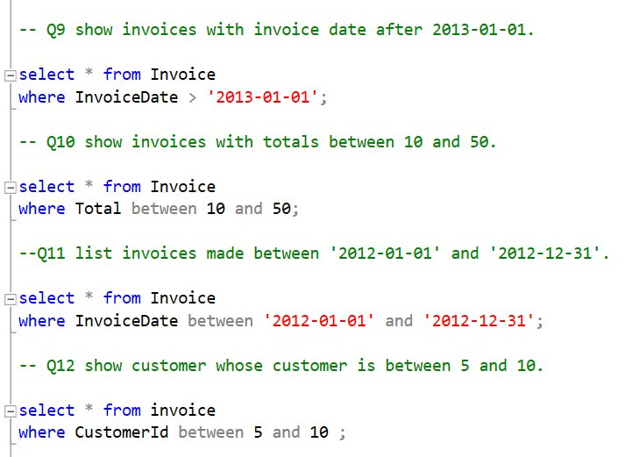
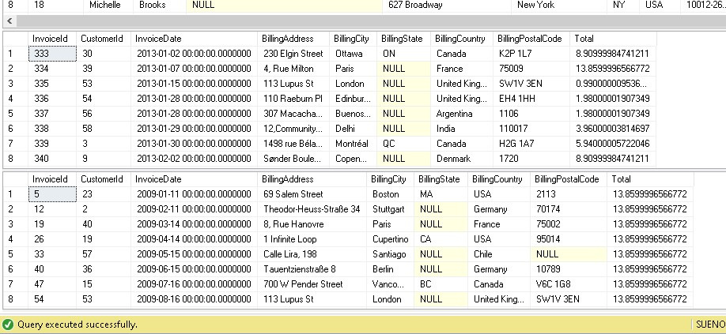
INVOICE AFTER 01 JANUARY 2013

Slide 11
CUSTOMER WITH TOTAL INVOICE BETWEEN 10 AND 50

Slide 12
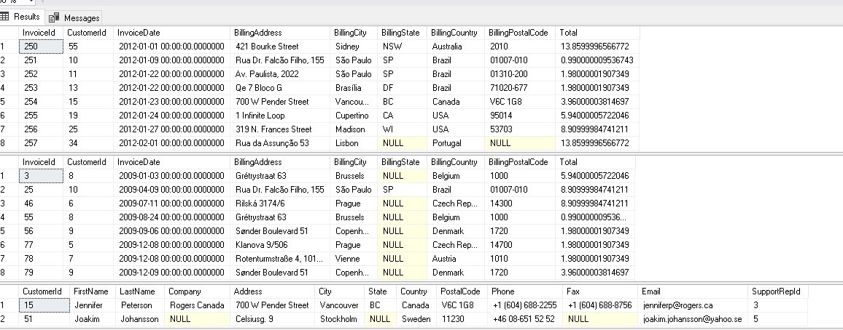
INVOICE LIST OF YEAR 2012

Slide 13
CUSTOMER WITH TOTAL INVOICE BETWEEN 5 AND 10

Slide 14
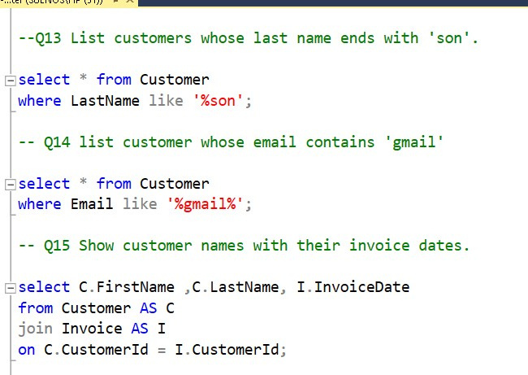
CUSTOMER WHOSE LAST NAME ENDS WITH 'SON'

Slide 15
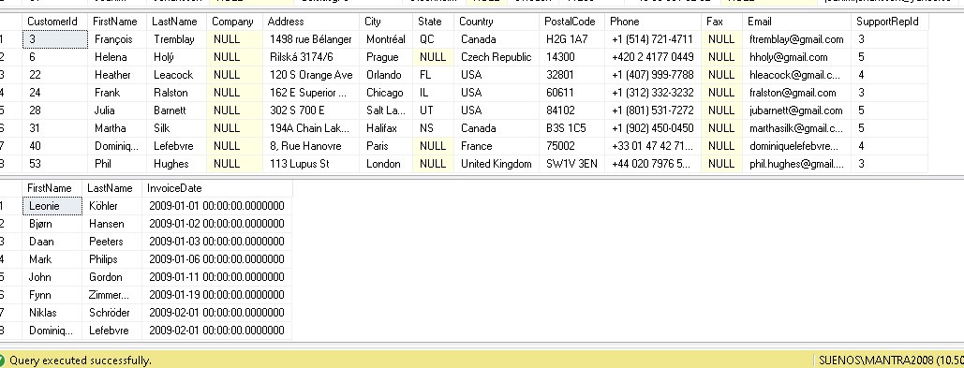
CUSTOMER WHOSE EMAIL CONTAINS 'GMAIL'

Slide 16
CUSTOMER NAME AND THEIR INVOICE DATE

Slide 17
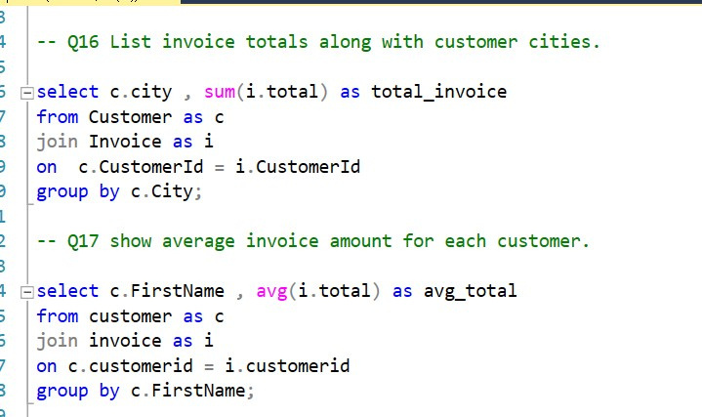
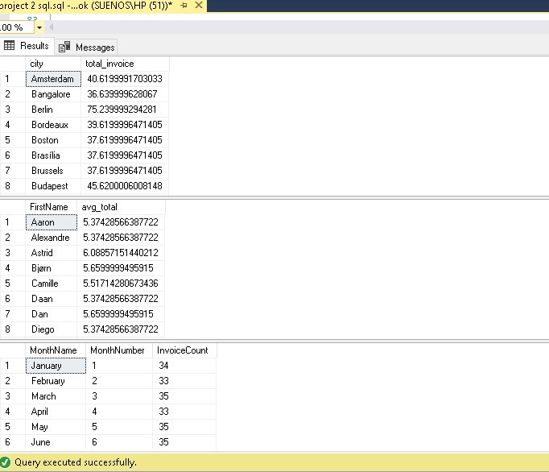
TOTAL INVOICE WITH CITIES

Slide 18
INVOICE AMOUNT FOR EACH CUSTOMER

Slide 19
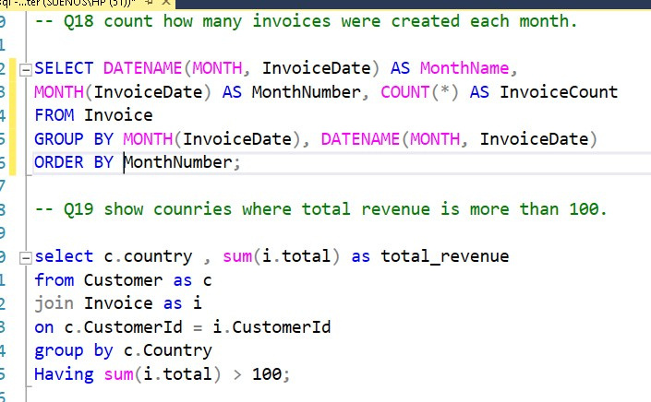
COUNT OF INVOICE CREATED PER MONTH

Slide 20
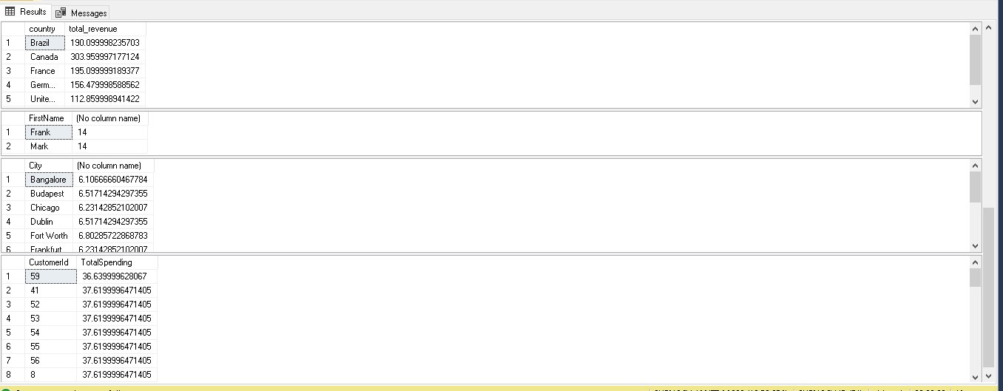
COUNTRIES WITH TOTAL REVENUE MORE THAN 100

Slide 21
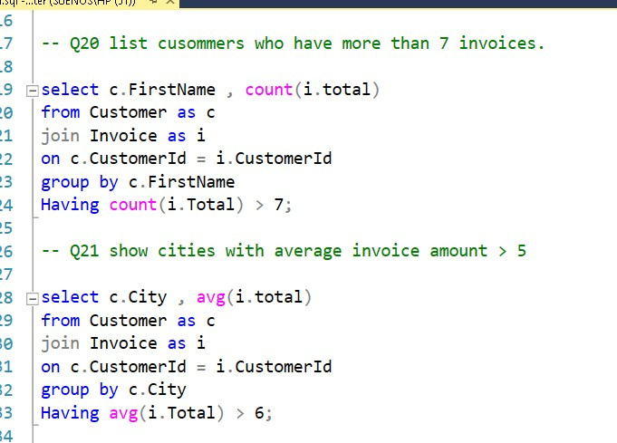
CUSTOMER WITH MORE THAN 7 INVOICE

Slide 22
CUSTOMER HAVING AVERAGE INVOICE AMOUNT ABOVE 5

Slide 23
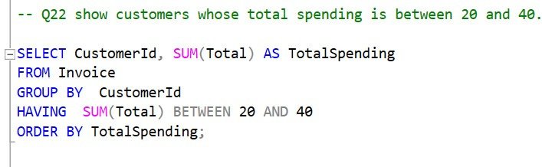
CUSTOMER HAVING TOTAL SPENDING BETWEEN 20 AND 40

Slide 24
THANK YOU
Hopefully, this report can make our company even better

